Slide 1
Health
WWS 2024

Slide 2
GENERAL HEALTH PERCEPTION
GENERAL HEALTH PERCEPTION

Slide 3
Health self-perception - Overall
% within total population
Very healthy
Healthy
Somewhat unhealthy
Unhealthy
Global Average
2018 | 2019 | 2020 | 2021 | 2022/2023 | 2024 | Variation
16% | 19% | 20% | 18% | 18% | 17% | -1
60% | 58% | 59% | 59% | 58% | 57% | -1
19% | 19% | 17% | 18% | 19% | 21% | +2
4% | 4% | 3% | 4% | 4% | 4% | 0
2024
Dk/Nr: 1%
14%
20%
By gender
58%
56%
By age group
23%
20%
4%
4%
Source: WIN 2024. Base: 33866 cases. The percentages of Dk / Nr have not been plotted.
Q1. How do you consider your overall health in general?

Slide 4
Health self-perception - Overall
% within total population
Very healthy
Healthy
Somewhat unhealthy
Unhealthy
 | By education level
 | By employment
No education / Only basic education
Working full (include self-employed)
Completed Primary
Working Part-time
Unemployed
Completed Secondary School
Student
Completed University
Housewife
Completed Higher level of education (Masters, PHD, etc.)
Retired/Disabled
Source: WIN 2024. Base: 33866 cases. The percentages of Dk / Nr have not been plotted.
Q1. How do you consider your overall health in general?

Slide 5
Health self-perception - Overall
% within total population
TTB
Very Healthy / Healthy
BTB
Somewhat Unhealthy / Unhealthy
Source: WIN 2024. Base: 33866 cases. The percentages of Dk / Nr have not been plotted.
Q1. How do you consider your overall health in general?

Slide 6
Health self-perception - Overall
% within total population
TTB | 2021 | 2022/ 2023 | 2024
GLOBAL AVERAGE | 77% | 76% | 74%
Indonesia | No data | No data | 96%
Vietnam | 93% | 93% | 93%
Mexico | 87% | 88% | 93%
Paraguay | 84% | 85% | 89%
India | 89% | 92% | 89%
Laos | No data | No data | 87%
Malaysia | 88% | 77% | 86%
Iran | No data | No data | 86%
France | 81% | 79% | 84%
Pakistan | 91% | 85% | 84%
Sweden | No data | No data | 83%
Italy | 83% | 84% | 82%
South Korea | No data | No data | 80%
Philippines | 89% | 84% | 78%
Turkey | 76% | 80% | 76%
United States | 75% | 77% | 75%
Greece | 84% | 77% | 75%
Canada | 78% | 77% | 75%
Spain | 75% | 76% | 75%
Brazil | 76% | 78% | 74%
TTB | 2021 | 2022/ 2023 | 2024
Ecuador | 72% | 68% | 73%
Argentina | 80% | 77% | 72%
Germany | 71% | 68% | 72%
Belgium | No data | No data | 71%
Netherlands | No data | 64% | 71%
United Kindom | No data | No data | 70%
Croatia | 68% | 67% | 68%
Japan | 70% | 68% | 68%
Serbia | 76% | 71% | 68%
Slovenia | 77% | 64% | 68%
Ivory Coast | No data | 83% | 67%
Ireland | 73% | 72% | 67%
Palestine | No data | No data | 65%
Hong Kong | 60% | 60% | 64%
Peru | 72% | 70% | 63%
Finland | 62% | 59% | 58%
Chile | 57% | 63% | 56%
Poland | 55% | 47% | 54%
Nigeria | 92% | 90% | 50%
Source: WIN 2024. Base: 33866 cases. The percentages of Dk / Nr have not been plotted.
Q1. How do you consider your overall health in general?

Slide 7
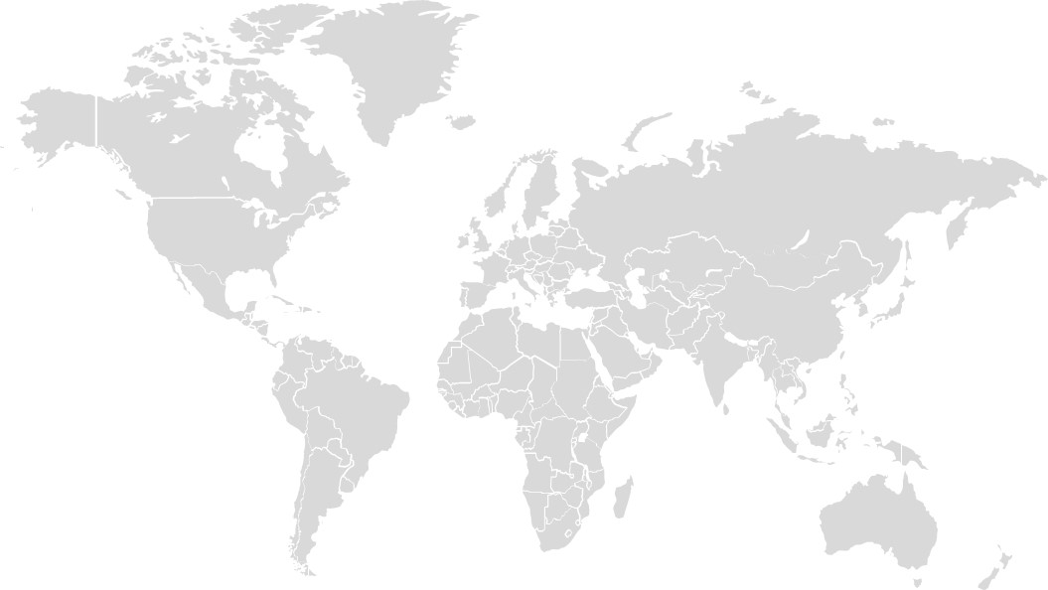
Health self-perception - Overall
% within total population
TTB
Very Healthy / Healthy
 | TOP 3 - 2024 | 2022/ 2023 | 2021
 | Indonesia 96% | Vietnam 93% | Vietnam 92%
 | Vietnam 93% | India 92% | Nigeria 91%
 | Mexico 93% | Nigeria 90% | Pakistan 90%
 | BOTTOM 3 -2024 | 2022/ 2023 | 2021
 | Chile 56% | Poland 59% | Hong Kong 60%
 | Poland 54% | Kenya 47% | Chile 57%
 | Nigeria 50% | Finland 47% | Poland 55%
1
37
2
38
3
39
EUROPE
71%
72%
83%
AMERICAS
79%
APAC
60%
MENA
AFRICA
Source: WIN 2024. Base: 33866 cases. The percentages of Dk / Nr have not been plotted.
Q1. How do you consider your overall health in general?

Slide 8
OWN OVERALL HEALTH
RATING

Slide 9
Summary of Overall health rating
% within total population
HOW WOULD YOU RATE EACH OF THE FOLLOWING ASPECTS,
WHEN THINKING OF YOUR OVERALL HEALTH…?
TTB
2022/ 2024
2023
72% | 66%
68% | 66%
57% | 67%
New | 68%
Fitness
Weight
Stress/ Mental Health
Sleeping
Very good
Quite good
Quite poor
Very poor
Source: WIN 2024. Base: 33866 cases. The percentages of Dk / Nr have not been plotted.
*In 2022/2023, the question focused solely on stress.
Q2. How would you rate each of the following aspects, when thinking of your overall health?

Slide 10
FITNESS

Slide 11
Overall health rating - Fitness
% within total population
Very good
Quite good
Quite poor
Very poor
Global Average
2022/ 2023 | 2024 | Variation
20% | 18% | -2
52% | 48% | -4
21% | 26% | +5
5% | 7% | +2
2024
Dk/Nr: 2%
15%
21%
48%
By age group
By gender
48%
28%
24%
8%
5%
Source: WIN 2024. Base: 33866 cases. The percentages of Dk / Nr have not been plotted.
Q2. How would you rate each of the following aspects, when thinking of your overall health? - Fitness

Slide 12
Overall health rating - Fitness
% within total population
Very good
Quite good
Quite poor
Very poor
 | By education level
 | By employment
No education / Only basic education
Working full (include self-employed)
Completed Primary
Working Part-time
Unemployed
Completed Secondary School
Student
Completed University
Housewife
Completed Higher level of education (Masters, PHD, etc.)
Retired/Disabled
Source: WIN 2024. Base: 33866 cases. The percentages of Dk / Nr have not been plotted.
Q2. How would you rate each of the following aspects, when thinking of your overall health? - Fitness

Slide 13
Overall health rating - Fitness
% within total population
TTB
Very good/ Quite good
BTB
Quite poor/ Very poor
Source: WIN 2024. Base: 33866 cases. The percentages of Dk / Nr have not been plotted.
Q2. How would you rate each of the following aspects, when thinking of your overall health? - Fitness

Slide 14
Overall health rating - Fitness
% within total population
TTB | 2022/ 2023 | 2024
GLOBAL AVERAGE | 76% | 74%
Indonesia | No data | 94%
Vietnam | 95% | 93%
Paraguay | 92% | 90%
Philippines | 89% | 88%
India | 90% | 86%
Pakistan | 87% | 85%
Mexico | 80% | 83%
Iran | No data | 81%
France | 71% | 77%
Malaysia | 60% | 76%
Palestine | No data | 74%
Turkey | 75% | 72%
Italy | 75% | 71%
Brazil | 75%% | 69%
Ivory Coast | 73% | 69%
Japan | 71% | 68%
Ecuador | 64% | 66%
Belgium | No data | 66%
Slovenia | 68% | 65%
Finland | 72% | 65%
TTB | 2022/ 2023 | 2024
South Korea | No data | 64%
Greece | 70% | 64%
United Kindom | 64% | 62%
Hong Kong | 67% | 62%
Spain | 59% | 61%
Argentina | 75% | 61%
United States | 64% | 60%
Canada | 63% | 60%
Chile | 67% | 58%
Poland | 71% | 58%
Germany | 51% | 55%
Laos | No data | 53%
Sweden | No data | 52%
Netherlands | 60% | 51%
Nigeria | 87% | 50%
Ireland | 58% | 48%
Croatia | 53% | 46%
Peru | 59% | 46%
Serbia | No data | 36%
Source: WIN 2024. Base: 33866 cases. The percentages of Dk / Nr have not been plotted.
Q2. How would you rate each of the following aspects, when thinking of your overall health? - Fitness

Slide 15
Overall health rating - Fitness
% within total population
TTB
Very good/ Quite good
TTB
 | TOP 3 - 2024 | 2022/ 2023
 | Indonesia 94% | Vietnam 95%
 | Vietnam 93% | Paraguay 92%
 | Paraguay 90% | India 90%
 | BOTTOM 3 -2024 | 2022/2023
 | Croatia 46% | Croatia 59%
 | Peru 46% | Germany 47%
 | Serbia 36% | Serbia 47%
1
37
1
1
2
38
2
2
3
39
3
EUROPE
71%
72%
83%
AMERICAS
79%
APAC
60%
MENA
AFRICA
Source: WIN 2024. Base: 33866 cases. The percentages of Dk / Nr have not been plotted.
Q2. How would you rate each of the following aspects, when thinking of your overall health? - Fitness

Slide 16
WEIGHT

Slide 17
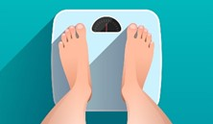
Overall health rating - Weight
% within total population
Very good
Quite good
Quite poor
Very poor
Global Average
2022/ 2023 | 2024 | Variation
17% | 19% | +2
49% | 47% | -2
25% | 26% | +1
7% | 6% | -1
2024
Dk/Nr: 2%
17%
22%
46%
By age group
By gender
47%
28%
25%
8%
5%
Source: WIN 2024. Base: 33866 cases. The percentages of Dk / Nr have not been plotted.
Q2. How would you rate each of the following aspects, when thinking of your overall health? - Weight

Slide 18
Overall health rating - Weight
% within total population
Very good
Quite good
Quite poor
Very poor
 | By education level
 | By employment
No education / Only basic education
Working full (include self-employed)
Completed Primary
Working Part-time
Unemployed
Completed Secondary School
Student
Completed University
Housewife
Completed Higher level of education (Masters, PHD, etc.)
Retired/Disabled
Source: WIN 2024. Base: 33866 cases. The percentages of Dk / Nr have not been plotted.
Q2. How would you rate each of the following aspects, when thinking of your overall health? - Weight

Slide 19
Overall health rating
% within total population
Overall health rating - Weight
% within total population
TTB
Very good/ Quite good
BTB
Quite poor/ Very poor
Source: WIN 2024. Base: 33866 cases. The percentages of Dk / Nr have not been plotted.
Q2. How would you rate each of the following aspects, when thinking of your overall health? - Weight

Slide 20
Overall health rating - Weight
% within total population
TTB | 2022/ 2023 | 2024
GLOBAL AVERAGE | 68% | 67%
Indonesia | No data | 94%
Vietnam | 95% | 92%
Pakistan | 87% | 86%
India | 84% | 84%
Paraguay | 84% | 82%
Philippines | 84% | 82%
Ivory Coast | 82% | 82%
Mexico | 71% | 81%
Iran | No data | 78%
Palestine | No data | 75%
Malaysia | 61% | 68%
Turkey | 67% | 68%
Brazil | 72% | 67%
Belgium | No data | 67%
Slovenia | 63% | 66%
France | 59% | 65%
Ecuador | 66% | 64%
South Korea | No data | 64%
Hong Kong | 68% | 64%
Spain | 64% | 64%
TTB | 2022/ 2023 | 2024
United States | 65% | 64%
Sweden | No data | 64%
Netherlands | 64% | 64%
Serbia | 73% | 64%
Italy | 66% | 62%
United Kindom | No data | 62%
Croatia | 67% | 62%
Germany | 58% | 61%
Finland | 60% | 60%
Canada | 66% | 60%
Argentina | 68% | 59%
Greece | 63% | 58%
Japan | 57% | 56%
Poland | 59% | 56%
Laos | No data | 55%
Ireland | 62% | 55%
Chile | 53% | 50%
Nigeria | 85% | 50%
Peru | 49% | 35%
Source: WIN 2024. Base: 33866 cases. The percentages of Dk / Nr have not been plotted.
Q2. How would you rate each of the following aspects, when thinking of your overall health? - Weight

Slide 21
Overall health rating - Weight
% within total population
TTB
Very good/ Quite good
TOP 3 - 2024 | 2022/ 2023
Indonesia 94% | Vietnam 95%
Vietnam 92% | Pakistan 87%
Pakistan 86% | Nigeria 85%
BOTTOM 3 -2024 | 2022/ 2023
Chile 50% | Japan 57%
Nigeria 50% | Peru 49%
Peru 35% | Kenya 41%
1
37
2
38
3
39
EUROPE
62%
59%
75%
AMERICAS
75%
APAC
68%
MENA
AFRICA
Source: WIN 2024. Base: 33866 cases. The percentages of Dk / Nr have not been plotted.
Q2. How would you rate each of the following aspects, when thinking of your overall health? - Weight

Slide 22
STRESS/ MENTAL HEALTH

Slide 23
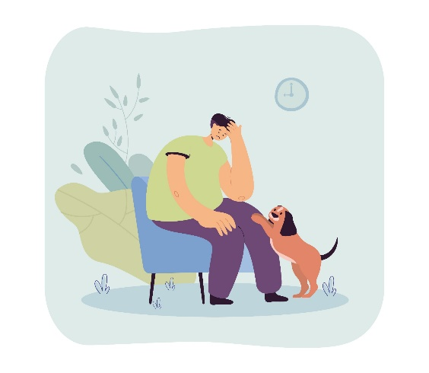
Overall health rating – Stress/ Mental Health
% within total population
Very good
Quite good
Quite poor
Very poor
Global Average
2022/ 2023 | 20234 | Variation
15% | 20% | +5
42% | 47% | +5
28% | 23% | -5
13% | 9% | -4
2024
Dk/Nr: 2%
16%
23%
47%
By age group
By gender
47%
25%
20%
11%
8%
Source: WIN 2024. Base: 33866 cases. The percentages of Dk / Nr have not been plotted.
*In 2022/2023, the question focused solely on stress.
Q2. How would you rate each of the following aspects, when thinking of your overall health? – Stress/ Mental Health

Slide 24
Overall health rating – Stress/ Mental Health
% within total population
Very good
Quite good
Quite poor
Very poor
 | By education level
 | By employment
No education / Only basic education
Working full (include self-employed)
Completed Primary
Working Part-time
Unemployed
Completed Secondary School
Student
Completed University
Housewife
Completed Higher level of education (Masters, PHD, etc.)
Retired/Disabled
Source: WIN 2024. Base: 33866 cases. The percentages of Dk / Nr have not been plotted.
Q2. How would you rate each of the following aspects, when thinking of your overall health? – Stress/ Mental Health

Slide 25
Overall health rating – Stress/ Mental Health
% within total population
TTB
Very good/ Quite good
BTB
Quite poor/ Very poor
Source: WIN 2024. Base: 33866 cases. The percentages of Dk / Nr have not been plotted.
Q2. How would you rate each of the following aspects, when thinking of your overall health? – Stress/ Mental Health

Slide 26
Overall health rating – Stress/ Mental Health
% within total population
TTB | 2022/ 2023 | 2024
GLOBAL AVERAGE | 57% | 66%
Paraguay | 80% | 97%
Indonesia | No data | 91%
Vietnam | 76% | 89%
Mexico | 70% | 88%
Pakistan | 77% | 86%
India | 58% | 78%
Malaysia | 58% | 74%
Finland | 60% | 74%
Netherlands | No data | 72%
Philippines | 44% | 71%
Palestine | No data | 71%
Croatia | 52% | 70%
Brazil | 53% | 69%
Slovenia | 60% | 69%
Sweden | No data | 69%
United States | 58% | 68%
Canada | 63% | 68%
Ireland | 60% | 68%
South Korea | No data | 67%
Ivory Coast | 61% | 66%
TTB | 2022/ 2023 | 2024
Italy | 52% | 66%
Belgium | No data | 65%
Germany | 60% | 65%
Turkey | 49% | 64%
Spain | 48% | 64%
Iran | No data | 63%
Hong Kong | 58% | 63%
United Kindom | No data | 63%
Chile | 56% | 63%
France | 57% | 60%
Poland | 51% | 60%
Serbia | 47% | 59%
Japan | 56% | 58%
Greece | 45% | 57%
Ecuador | 44% | 51%
Nigeria | 63% | 50%
Laos | No data | 49%
Peru | 32% | 40%
Argentina | 42% | 36%
Source: WIN 2024. Base: 33866 cases. The percentages of Dk / Nr have not been plotted.
*In 2022/2023, the question focused solely on stress.
Q2. How would you rate each of the following aspects, when thinking of your overall health? – Stress/ Mental Health

Slide 27
Overall health rating – Stress/ Mental Health
% within total population
TTB
Very good/ Quite good
TOP 3 - 2024 | 2022/2023
Paraguay 97% | Paraguay 80%
Indonesia 91% | Pakistan 77%
Vietnam 89% | Vietnam 76%
BOTTOM 3 -2024 | 2022/ 2023
Laos 49% | Argentina 57%
Peru 40% | Kenya 49%
Argentina 36% | Peru 41%
1
37
2
38
3
39
EUROPE
66%
61%
75%
AMERICAS
73%
APAC
59%
MENA
AFRICA
Source: WIN 2024. Base: 33866 cases. The percentages of Dk / Nr have not been plotted.
*In 2022/2023, the question focused solely on stress.
Q2. How would you rate each of the following aspects, when thinking of your overall health? – Stress/ Mental Health

Slide 28
SLEEPING

Slide 29
Overall health rating - Sleeping
% within total population
Very good
Quite good
Quite poor
Very poor
Total
20%
25%
46%
46%
By gender
26%
24%
7%
5%
2024
By age group
Dk/Nr: 1%
Source: WIN 2024. Base: 33866 cases. The percentages of Dk / Nr have not been plotted.
Q2. How would you rate each of the following aspects, when thinking of your overall health? - Sleeping

Slide 30
Overall health rating - Sleeping
% within total population
Very good
Quite good
Quite poor
Very poor
 | By education level
 | By employment
No education / Only basic education
Completed Primary
Completed Secondary School
Completed University
Completed Higher level of education (Masters, PHD, etc.)
Working full (include self-employed)
Working Part-time
Unemployed
Student
Housewife
Retired/Disabled
Source: WIN 2024. Base: 33866 cases. The percentages of Dk / Nr have not been plotted.
Q2. How would you rate each of the following aspects, when thinking of your overall health? - Sleeping

Slide 31
Overall health rating - Sleeping
% within total population
TTB
Very good/ Quite good
BTB
Quite poor/ Very poor
Source: WIN 2024. Base: 33866 cases. The percentages of Dk / Nr have not been plotted.
Q2. How would you rate each of the following aspects, when thinking of your overall health? - Sleeping

Slide 32
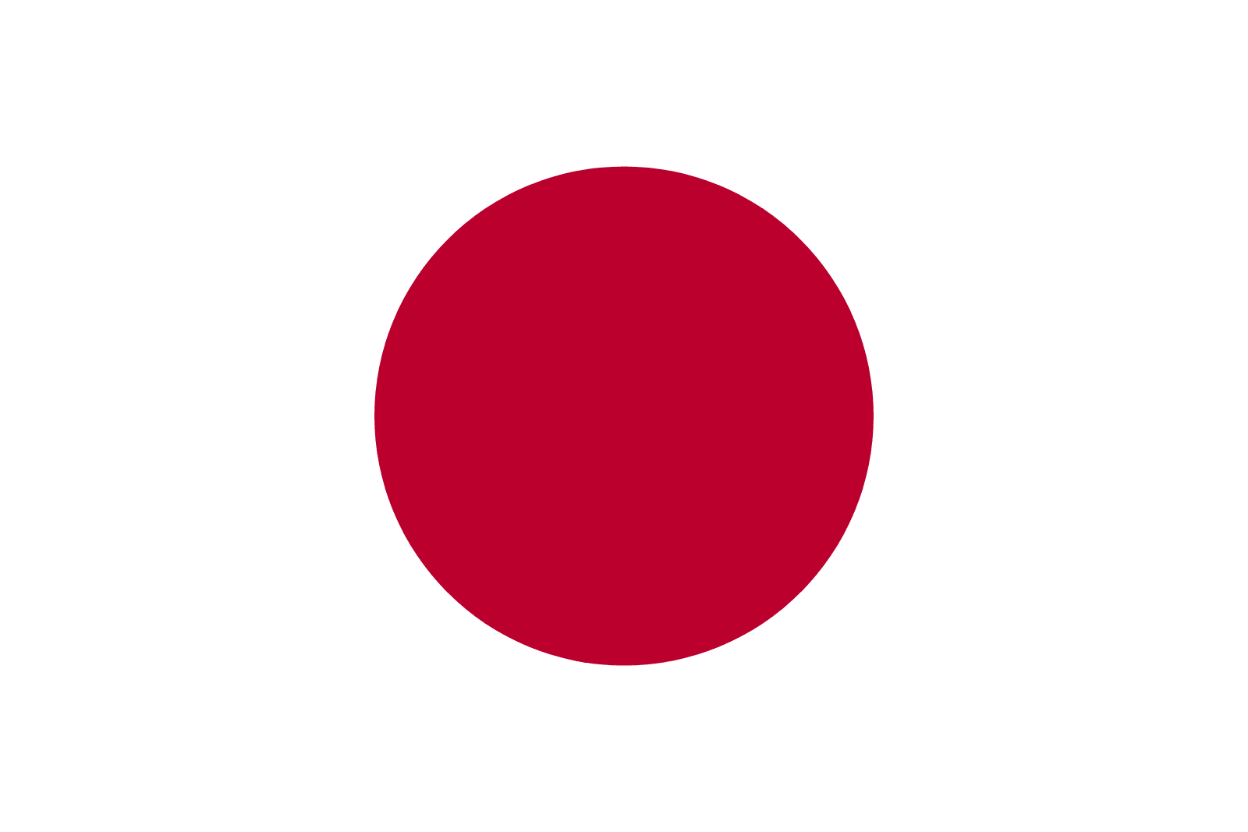
Overall health rating - Sleeping
% within total population
TTB
Very good/ Quite good
TOP 3 - 2024
Indonesia 92%
Vietnam 90%
Paraguay 86%
BOTTOM 3 -2024
Japan 48%
Peru 48%
Nigeria 43%
1
37
2
38
3
39
EUROPE
67%
64%
74%
AMERICAS
69%
APAC
64%
MENA
AFRICA
Source: WIN 2024. Base: 33866 cases. The percentages of Dk / Nr have not been plotted.
Q2. How would you rate each of the following aspects, when thinking of your overall health? - Sleeping

Slide 33
STRESS IN DAILY LIFE

Slide 34
Stress in daily life
% within total population
Never
Almost never
Sometimes
Fairly often
Very often
4%
8%
Total
13%
18%
49%
49%
By gender
25%
17%
10%
7%
2024
By age group
Source: WIN 2024. Base: 33866 cases. The percentages of Dk / Nr have not been plotted.
Q3. How often would you say you feel stress in your daily life?

Slide 35
Stress in daily life
% within total population
Never
Almost never
Sometimes
Fairly often
Very often
 | By education level
 | By employment
No education / Only basic education
Completed Primary
Completed Secondary School
Completed University
Completed Higher level of education (Masters, PHD, etc.)
Working full (include self-employed)
Working Part-time
Unemployed
Student
Housewife
Retired/Disabled
Source: WIN 2024. Base: 33866 cases. The percentages of Dk / Nr have not been plotted.
Q3. How often would you say you feel stress in your daily life?

Slide 36
Stress in daily life
% within total population
Never/ Almost Never
Sometimes
Fairly Often/ Very Often
Source: WIN 2024. Base: 33866 cases. The percentages of Dk / Nr have not been plotted.
Q3. How often would you say you feel stress in your daily life?

Slide 37
Stress in daily life
% within total population
TTB
Never/ Almost Never
TOP 3 - 2024
Pakistan 50%
Indonesia 46%
Vietnam 33%
BOTTOM 3 -2024
Croatia 10%
Greece 8%
Serbia 8%
1
37
2
38
3
39
EUROPE
20%
19%
26%
AMERICAS
19%
APAC
20%
MENA
AFRICA
Source: WIN 2024. Base: 33866 cases. The percentages of Dk / Nr have not been plotted.
Q3. How often would you say you feel stress in your daily life?

Slide 38
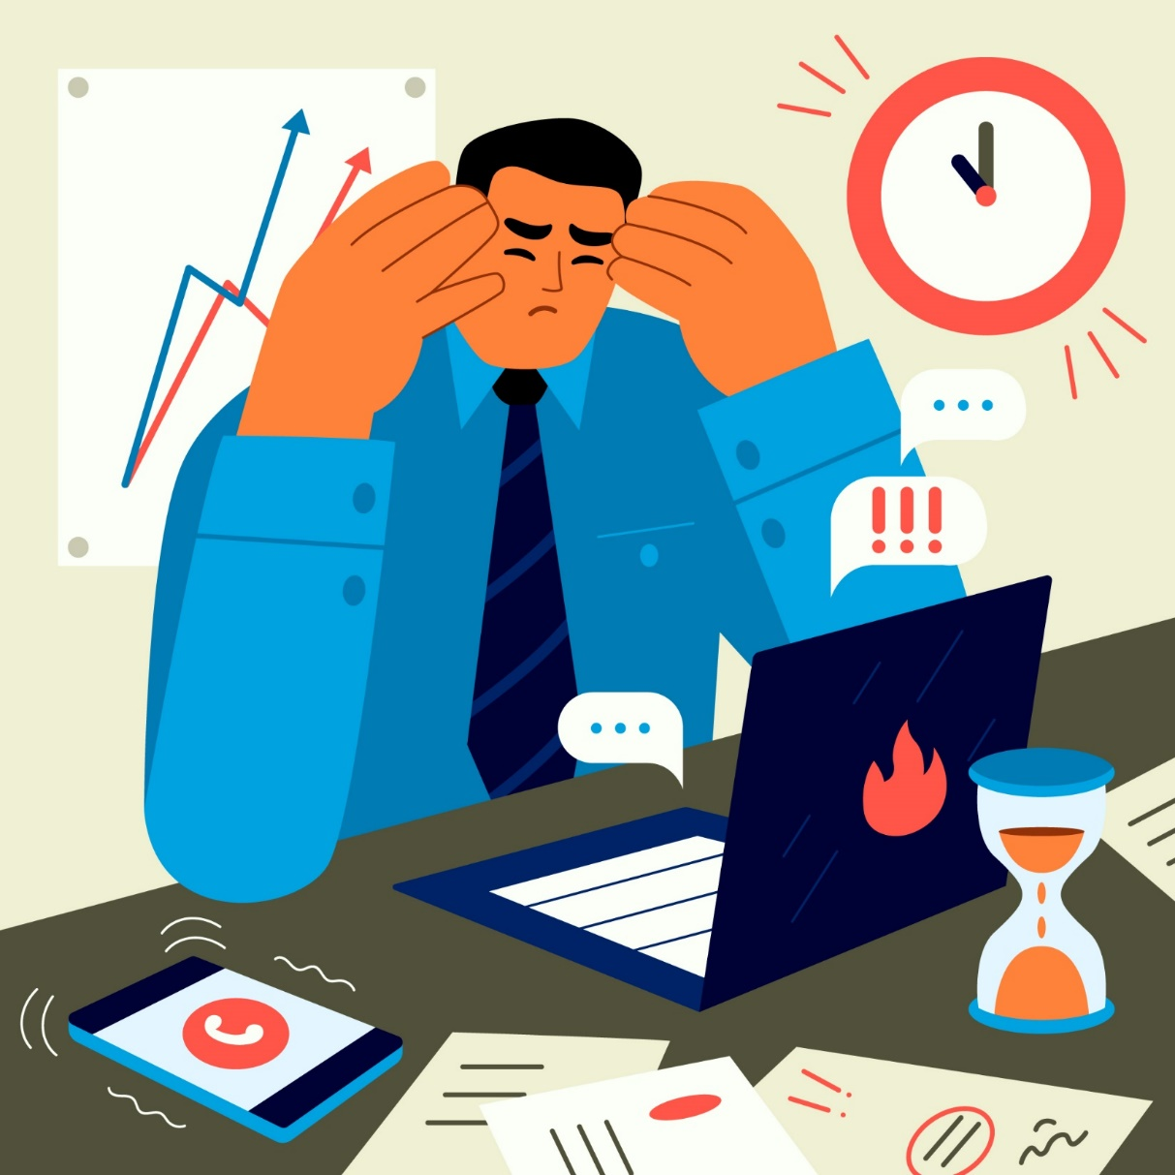
CAUSES OF STRESS

Slide 39
Causes of stress
% within total population
Total
By gender
My job
Lack of money
My family
My health
Lack of job/unemployment
Changes in life (moving, changing job)
The wars around the world
Environmental disasters
Source: WIN 2024. Base: 33866 cases. The percentages of Dk / Nr have not been plotted.
Q4. Thinking about the last time you were really stressed, what was it that made you stressed?

Slide 40
Causes of stress
% within total population
By age group
18 – 24
25 – 34
35 – 44
45 – 54
55 – 64
65+
My job
Lack of money
My family
My health
Lack of job/unemployment
Changes in life (moving, changing job)
The wars around the world
Environmental disasters
Source: WIN 2024. Base: 33866 cases. The percentages of Dk / Nr have not been plotted.
Q4. Thinking about the last time you were really stressed, what was it that made you stressed?

Slide 41
Causes of stress
% within total population
By education level
No education/ only basic education
Completed
Primary
Completed Secondary
School
Completed High level
education
Master.
PHD.
My job
Lack of money
My family
My health
Lack of job/unemployment
Changes in life (moving, changing job)
The wars around the world
Environmental disasters
Source: WIN 2024. Base: 33866 cases. The percentages of Dk / Nr have not been plotted.
Q4. Thinking about the last time you were really stressed, what was it that made you stressed?

Slide 42
Causes of stress
% within total population
By employment
Working full (include
self-employed)
Working
Part-time
Unemployed
Student
Housewife
Retired/
Disabled
My job
Lack of money
My family
My health
Lack of job/unemployment
Changes in life (moving, changing job)
The wars around the world
Environmental disasters
Source: WIN 2024. Base: 33866 cases. The percentages of Dk / Nr have not been plotted.
Q4. Thinking about the last time you were really stressed, what was it that made you stressed?

Slide 43
Causes of stress
% within total population
 | My job | Lack of money | My family | My health | Lack of job | Changes in life | The wars around the world | Environmental disasters
Argentina | 21% | 29% | 14% | 5% | 17% | 5% | 2% | 1%
Belgium | 24% | 16% | 22% | 11% | 2% | 12% | 4% | 1%
Brazil | 20% | 34% | 15% | 4% | 11% | 4% | 4% | 2%
Canada | 20% | 21% | 23% | 10% | 5% | 8% | 4% | 2%
Ivory Coast | 23% | 21% | 28% | 7% | 16% | 1% | 0% | 1%
Chile | 21% | 33% | 12% | 5% | 15% | 6% | 1% | 1%
Germany | 27% | 14% | 15% | 16% | 1% | 7% | 10% | 3%
Ecuador | 14% | 19% | 14% | 7% | 27% | 4% | 6% | 0%
Spain | 27% | 17% | 19% | 12% | 6% | 5% | 4% | 1%
Finland | 30% | 15% | 18% | 11% | 3% | 6% | 6% | 1%
France | 26% | 17% | 20% | 10% | 3% | 6% | 5% | 3%
United Kingdom | 18% | 25% | 19% | 13% | 5% | 7% | 5% | 1%
Greece | 24% | 30% | 20% | 7% | 6% | 6% | 3% | 1%
Hong Kong | 37% | 20% | 14% | 10% | 5% | 6% | 2% | 2%
Croatia | 27% | 10% | 28% | 11% | 5% | 7% | 3% | 3%
Indonesia | 19% | 25% | 12% | 9% | 5% | 5% | 2% | 2%
Ireland | 15% | 24% | 26% | 11% | 2% | 10% | 4% | 1%
India | 18% | 21% | 23% | 7% | 6% | 11% | 3% | 9%
Iran | 23% | 23% | 28% | 5% | 4% | 7% | 3% | 1%
Italy | 31% | 15% | 21% | 8% | 6% | 8% | 3% | 2%
Source: WIN 2024. Base: 33866 cases. The percentages of Dk / Nr have not been plotted.
Q4. Thinking about the last time you were really stressed, what was it that made you stressed?

Slide 44
Causes of stress
% within total population
 | My job | Lack of money | My family | My health | Lack of job | Changes in life | The wars around the world | Environmental disasters
Japan | 24% | 11% | 19% | 13% | 3% | 3% | 4% | 8%
South Korea | 27% | 29% | 17% | 8% | 8% | 3% | 4% | 2%
Laos | 22% | 34% | 21% | 5% | 4% | 2% | 1% | 2%
Mexico | 48% | 16% | 21% | 4% | 3% | 4% | 3% | 1%
Malysia | 25% | 39% | 11% | 6% | 5% | 5% | 0% | 4%
Nigeria | 31% | 32% | 12% | 15% | 0% | 8% | 0% | 1%
Netherlands | 17% | 10% | 20% | 16% | 2% | 11% | 7% | 2%
Peru | 22% | 23% | 16% | 9% | 14% | 6% | 3% | 3%
Philippines | 10% | 42% | 11% | 3% | 15% | 5% | 2% | 2%
Pakistan | 13% | 15% | 17% | 8% | 14% | 3% | 2% | 2%
Poland | 18% | 11% | 24% | 17% | 3% | 6% | 7% | 1%
Palestine | 5% | 6% | 20% | 7% | 11% | 7% | 39% | 3%
Paraguay | 51% | 10% | 13% | 4% | 5% | 11% | 0% | 1%
Serbia | 25% | 16% | 27% | 10% | 7% | 6% | 4% | 1%
Sweden | 30% | 13% | 16% | 7% | 4% | 9% | 6% | 2%
Slovenia | 35% | 11% | 21% | 10% | 3% | 6% | 3% | 3%
Turkey | 17% | 24% | 13% | 4% | 5% | 7% | 12% | 11%
United States | 19% | 22% | 21% | 9% | 4% | 8% | 4% | 2%
Vietnam | 45% | 17% | 13% | 8% | 6% | 5% | 1% | 2%
Source: WIN 2024. Base: 33866 cases. The percentages of Dk / Nr have not been plotted.
Q4. Thinking about the last time you were really stressed, what was it that made you stressed?

Slide 45
Causes of stress
% within total population
TOP 3 BOTTOM 3
My job
Lack of money
Paraguay | 51% | Ecuador | 14%
Mexico | 48% | Pakistan | 13%
Vietnam | 45% | Philippines | 10%
Philippines | 42% | Slovenia | 11%
Malaysia | 39% | Paraguay | 10%
Laos | 34% | Netherlands | 10%
Lack of job/unemployment
Changes in life
Ecuador | 27% | Netherlands | 2%
Argentina | 17% | Ireland | 2%
Ivory Coast | 16% | Germany | 1%
Belgium | 12% | Pakistan | 3%
Paraguay | 11% | Japan | 3%
Netherlands | 11% | Laos | 2%
My family
Environmental disasters
Croatia | 28% | Chile | 12%
Iran | 28% | Indonesia | 12%
Ivory Coast | 28% | Philippines | 11%
Turkey | 11% | United Kingdom | 1%
India | 9% | Argentina | 1%
Japan | 8% | Finland | 1%
My health
The wars around the world
Poland | 17% | Turkey | 4%
Netherlands | 16% | Paraguay | 4%
Germany | 16% | Philippines | 3%
Palestine | 39% | Nigeria | 0%
Turkey | 12% | Malaysia | 0%
Germany | 10% | Paraguay | 0%
Source: WIN 2024. Base: 33866 cases. The percentages of Dk / Nr have not been plotted.
Q4. Thinking about the last time you were really stressed, what was it that made you stressed?

Slide 46
Causes of stress
% within total population
MENA
Middle East and North of Africa
14%
The wars around the world
12%
My family
4%
Environmental disasters
EUROPE
12%
My health
8%
Changes in life
APAC
25%
Lack of money
Asia Pacific
4%
Environmental disasters
AMERICAS
25%
Lack of money
AFRICA
19%
My job
11%
Lack of job/unemployment
26%
Lack of money
Source: WIN 2024. Base: 33866 cases. The percentages of Dk / Nr have not been plotted.
Q4. Thinking about the last time you were really stressed, what was it that made you stressed?

Slide 47
Total of 33 866 surveys worldwide
METHODOLOGY
METHODOLOGY
Dates: Dec. 1st 2023 to Feb. 4th 2024
 | Country | Company Name | Methodology | Sample | Coverage | 2023-2024 Fieldwork Dates
1 | Argentina | Voices Research & Consultancy | CAWI | 1035 | NATIONAL | 1-6 December 2023
2 | Belgium | IRB Europe | CAWI | 500 | NATIONAL | 26-31 January 2024
3 | Brazil | Market Analysis Brazil | CAWI | 1000 | NATIONAL | 9-24 January 2024
4 | Canada | LEGER | CAWI | 1000 | NATIONAL | 3-14 January 2024
5 | Chile | Activa Research | CAWI | 1094 | NATIONAL | January 2024
6 | Croatia | Institute for market and media research, Mediana Fides | CAWI | 585 | NATIONAL | 23-29 January 2024
7 | Ecuador | Centro de Estudios Y Datos - CEDATOS | CAPI | 505 | NATIONAL | 28 Jan – 3 Feb 2024
8 | Finland | Taloustutkimus Oy | Online Panel | 1128 | NATIONAL | 13-18 December 2023
9 | France | BVA | CAWI | 1000 | NATIONAL | 17-19 January 2024
10 | Germany | Produkt+Markt | CAWI | 1000 | NATIONAL | 22 Dec 2023- 22 Jan 2024
11 | Greece | Alternative Research Solutions | CAWI | 500 | NATIONAL | 10-15 January 2024
12 | Hong Kong | Consumer Search Group (CSG) | Online Panel | 500 | TERRITORY WIDE | 1-6 December 2023
13 | India | DataPrompt International Pvt. Ltd. | CAWI | 1000 | NATIONAL | 19 Dec 2023 - 25 Jan 2024
14 | Indonesia | DEKA | Face to Face | 1000 | NATIONAL | 5-26 December 2023
15 | Iran | EMRC | CATI | 1000 | URBAN | 18-31 December 2023
16 | Republic of Ireland | RED C Research & Marketing Ltd | CAWI | 1002 | NATIONAL | 5-10 January 2024
17 | Italy | BVA Doxa | CAWI | 1000 | NATIONAL | 17-19 January 2024
18 | Ivory Coast | EMC | CAPI | 1200 | NATIONAL | 9-28 January 2024
19 | Lao PDR | Indochina Research (LAOS) Ltd | CATI | 500 | 4 KEY REGIONS | 15 Dec 2023- 8 Jan 2024
20 | Japan | Nippon Research Center, LTD. | CAWI | 1118 | NATIONAL | 9-16 January 2024

Slide 48
Total of 33 866 surveys worldwide
METHODOLOGY
METHODOLOGY
Dates: Dec. 1st 2023 to Feb. 4th 2024
 | Country | Company Name | Methodology | Sample | Coverage | 2023-2024 Fieldwork Dates
21 | Malaysia | Central Force International | Online | 1000 | NATIONAL | 7-13 December 2023
22 | Mexico | Brand Investigation S.A.de C.V | Online | 500 | NATIONAL | 11-20 December 2023
23 | Nigeria | Market Trends International | CATI | 1000 | NATIONAL | 15 Dec 2023- 24 Jan 2024
24 | Pakistan | Gallup Pakistan | CATI | 1000 | NATIONAL | 3-17 January 2024
25 | Palestine | Palestinian Center for Public Opinion | TAPI | 483 | NATIONAL | 26 Sep - 5 Oct 2023
26 | Paraguay | ICA Consultoría Estratégica | CATI | 480 | NATIONAL | 18 Dec 2023 – 11 Jan 2024
27 | Peru | Datum Internacional | P2P | 1210 | NATIONAL | 6-9 January 2024
28 | Philippines | Philippine Survey and Research Center, Inc. (PSRC) | F2F CAPI | 1000 | NATIONAL | 12-27 January 2024
29 | Poland | Mareco Polska | CAWI | 1080 | NATIONAL | 2-5 January 2024
30 | Republic of Korea | Gallup Korea | CAWI | 1029 | NATIONAL | 24-30 January 2024
31 | Serbia | Institute for market and media research, Mediana Adria | CAWI | 501 | NATIONAL | 23-29 January 2024
32 | Slovenia | Institute for market and media research, Mediana | CAWI | 700 | NATIONAL | 23-27 January 2024
33 | Spain | Instituto DYM | CAWI | 1011 | NATIONAL | 13-15 December 2023
34 | Sweden | DEMOSKOP AB | CAWI | 1068 | NATIONAL | 4 Dec 2023 – 31 Jan 2024
35 | The Netherlands | Motivaction International B.V. | CAWI | 1005 | NATIONAL | 2-5 February 2024
36 | Turkey | Barem | CATI | 523 | NATIONAL | 26-30 January 2024
37 | United Kingdom | ORB International | CAWI | 1000 | NATIONAL
38 | USA | LEGER | CAWI | 1007 | NATIONAL | 3-14 January 2024
39 | Vietnam | Indochina Research (Vietnam) Ltd | CAPI | 600 | Hanoi, Ho Chi Minh city, Danang urban population | 29 Dec 2023 – 18 Jan 2024

